Slide 2
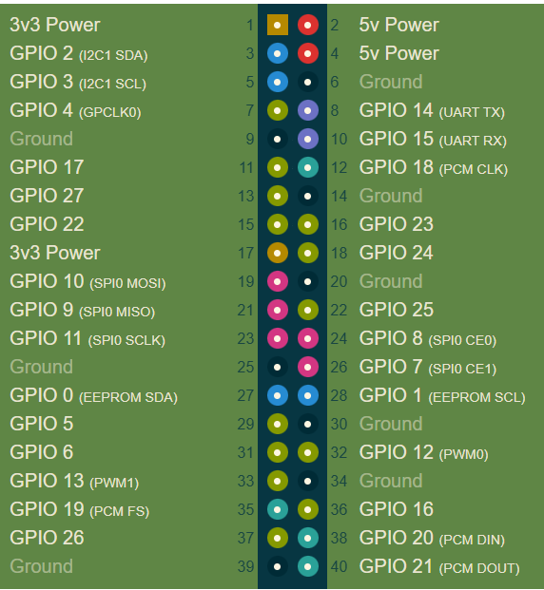
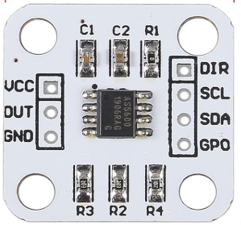
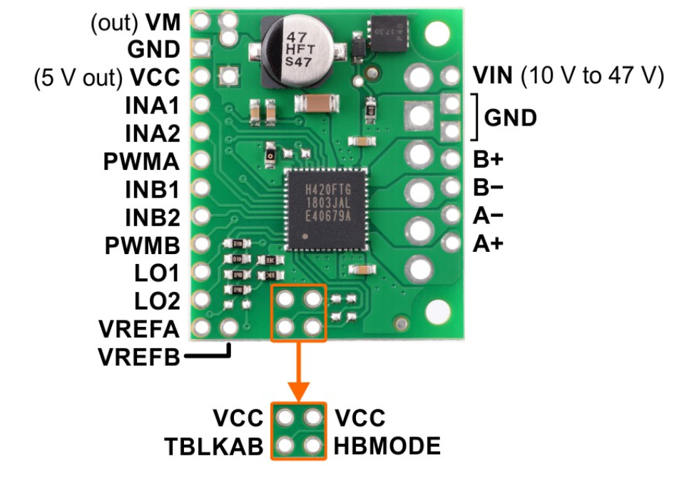
Pi pin
INA1 -> 22
INA2 -> 12
INB1 -> 8
INB2 -> 10
LSCL -> 5
LSDA -> 3
RSCL -> 21
RSDA -> 24

